Slide 1

B.Sc.Engg. In (CsE)
Level 2 Semester IV Math-221
Credit: 3.00 Marks: 100
Laplace Transform
Mehetaj parvine
Lecturer
Mathematics Department
Patuakhali Science and Technology University
Email: mehetajparvine@gmail.com
Cell: 01747792047
24-03-2021

Slide 2
Contents
Fourier series
Coefficient and half range Fourier series
Fourier Analysis
Fourier integral
Z-Transformation and its application
Laplace transforms
Application of Fourier series and Laplace Transform

Slide 3
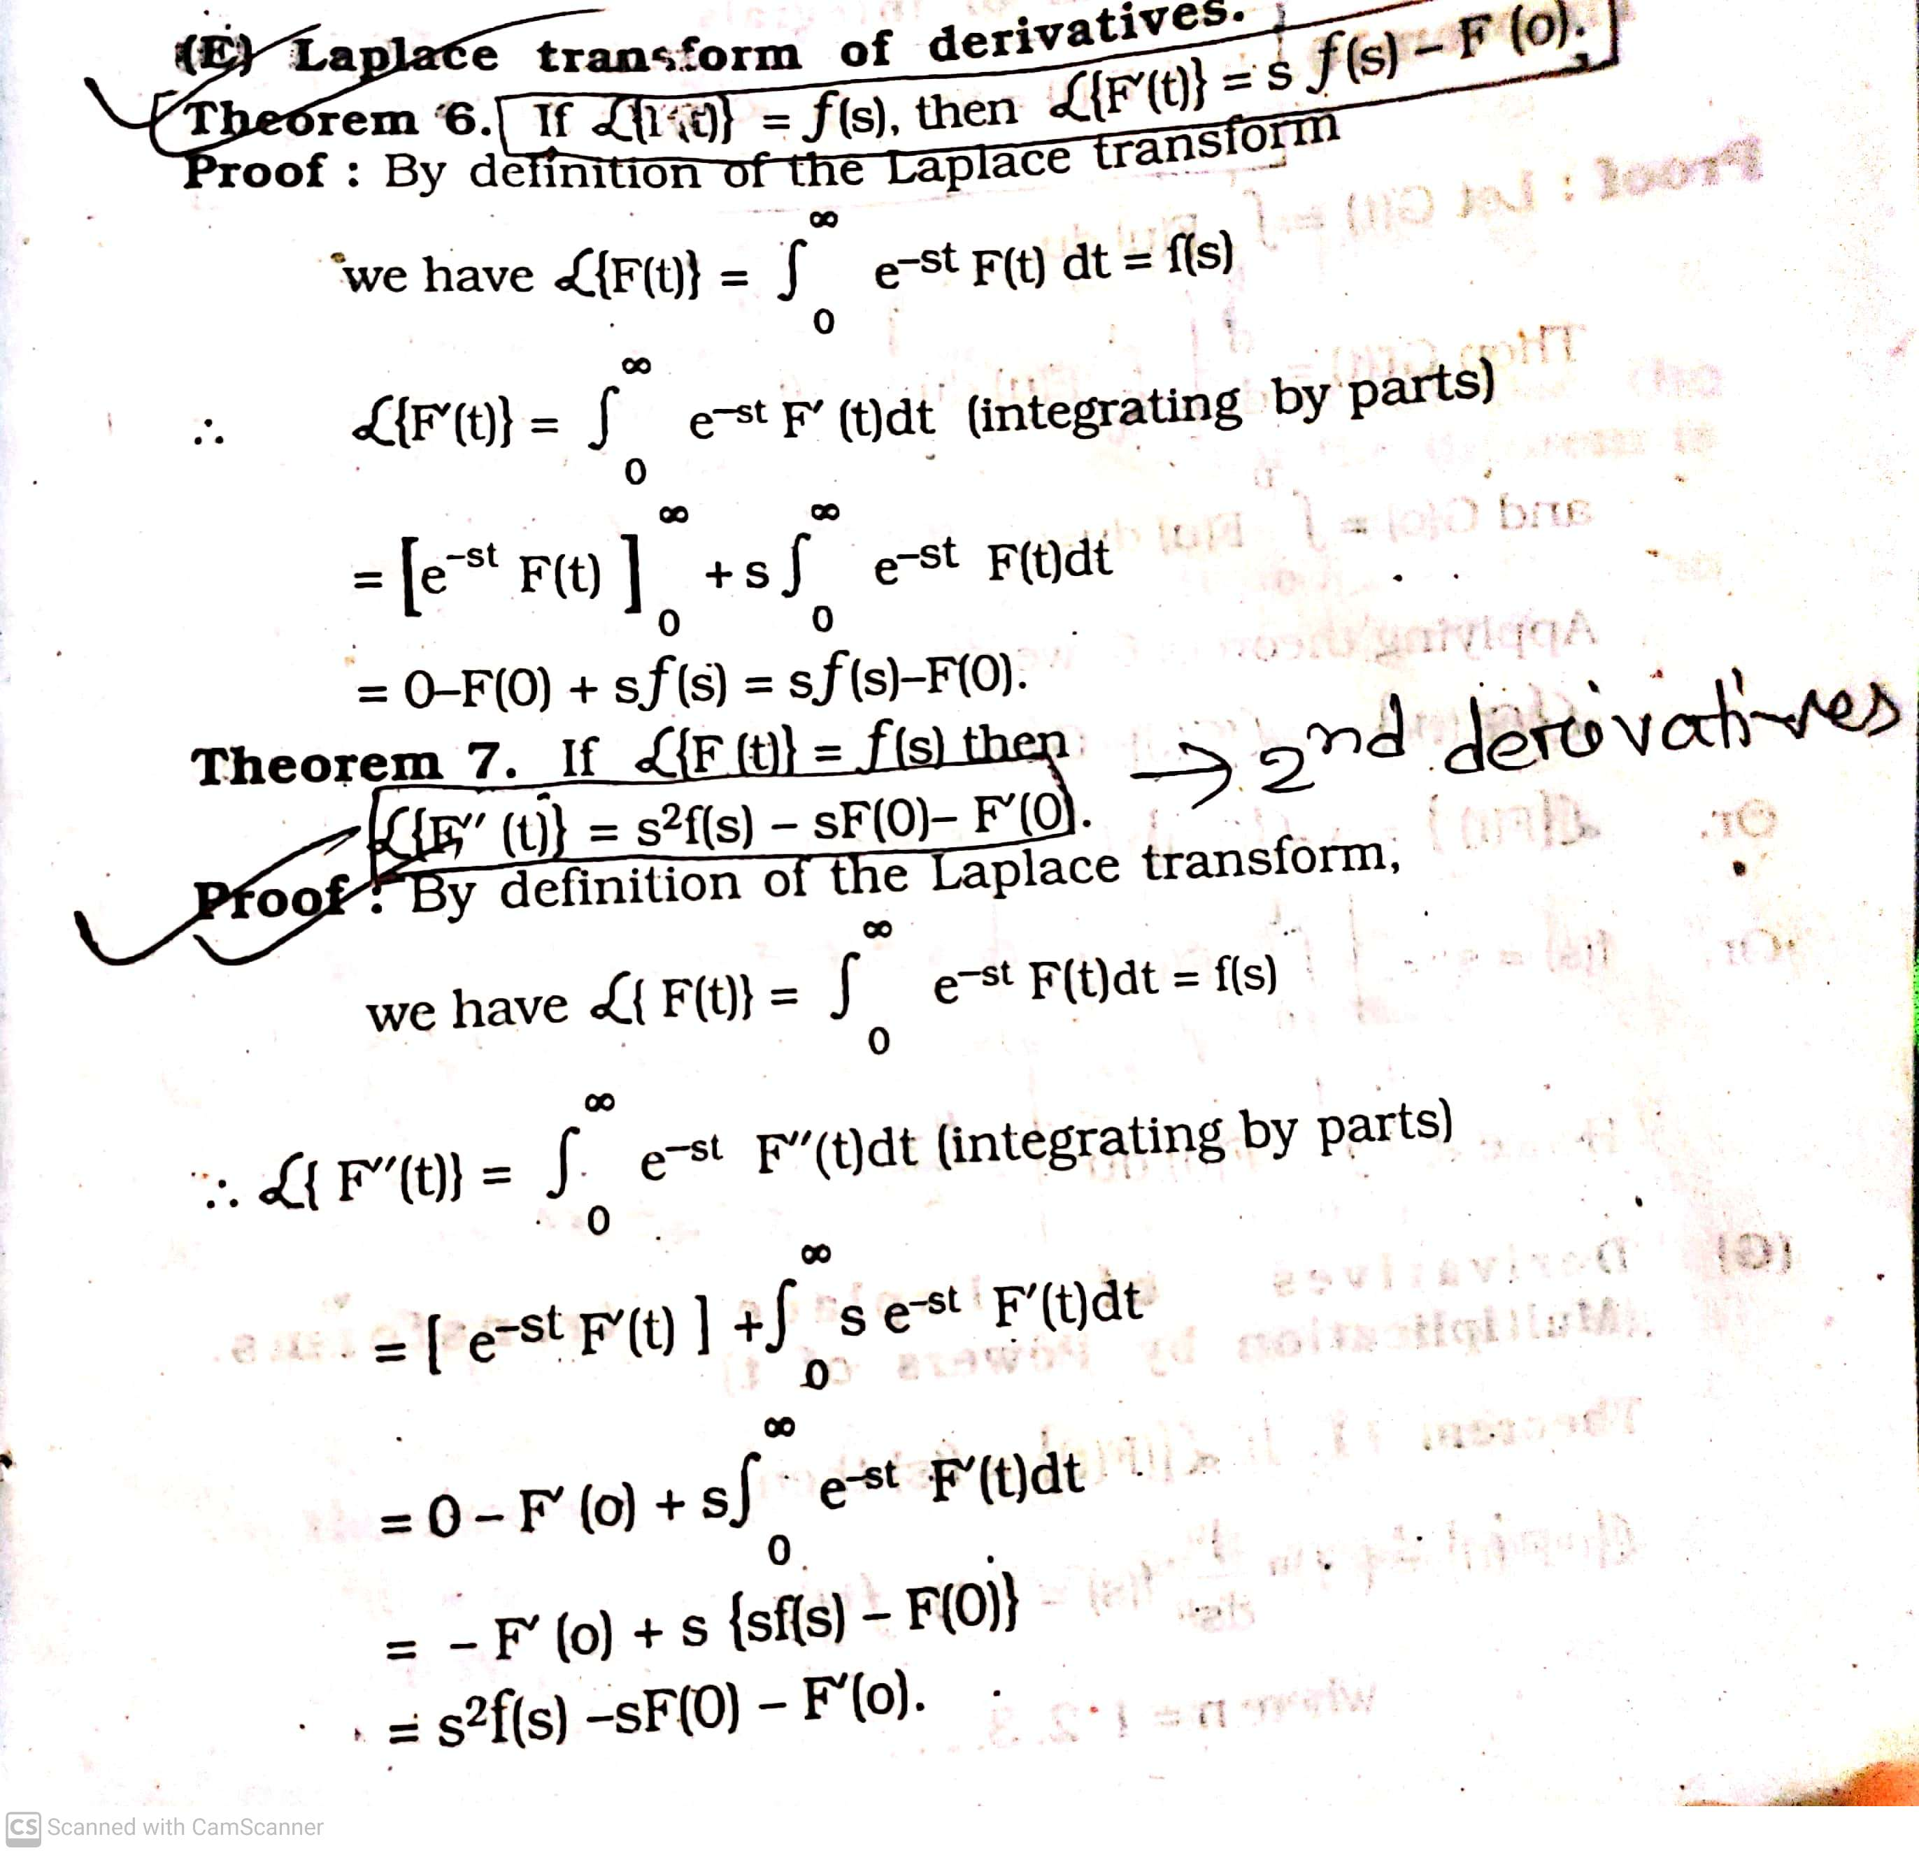

Slide 4
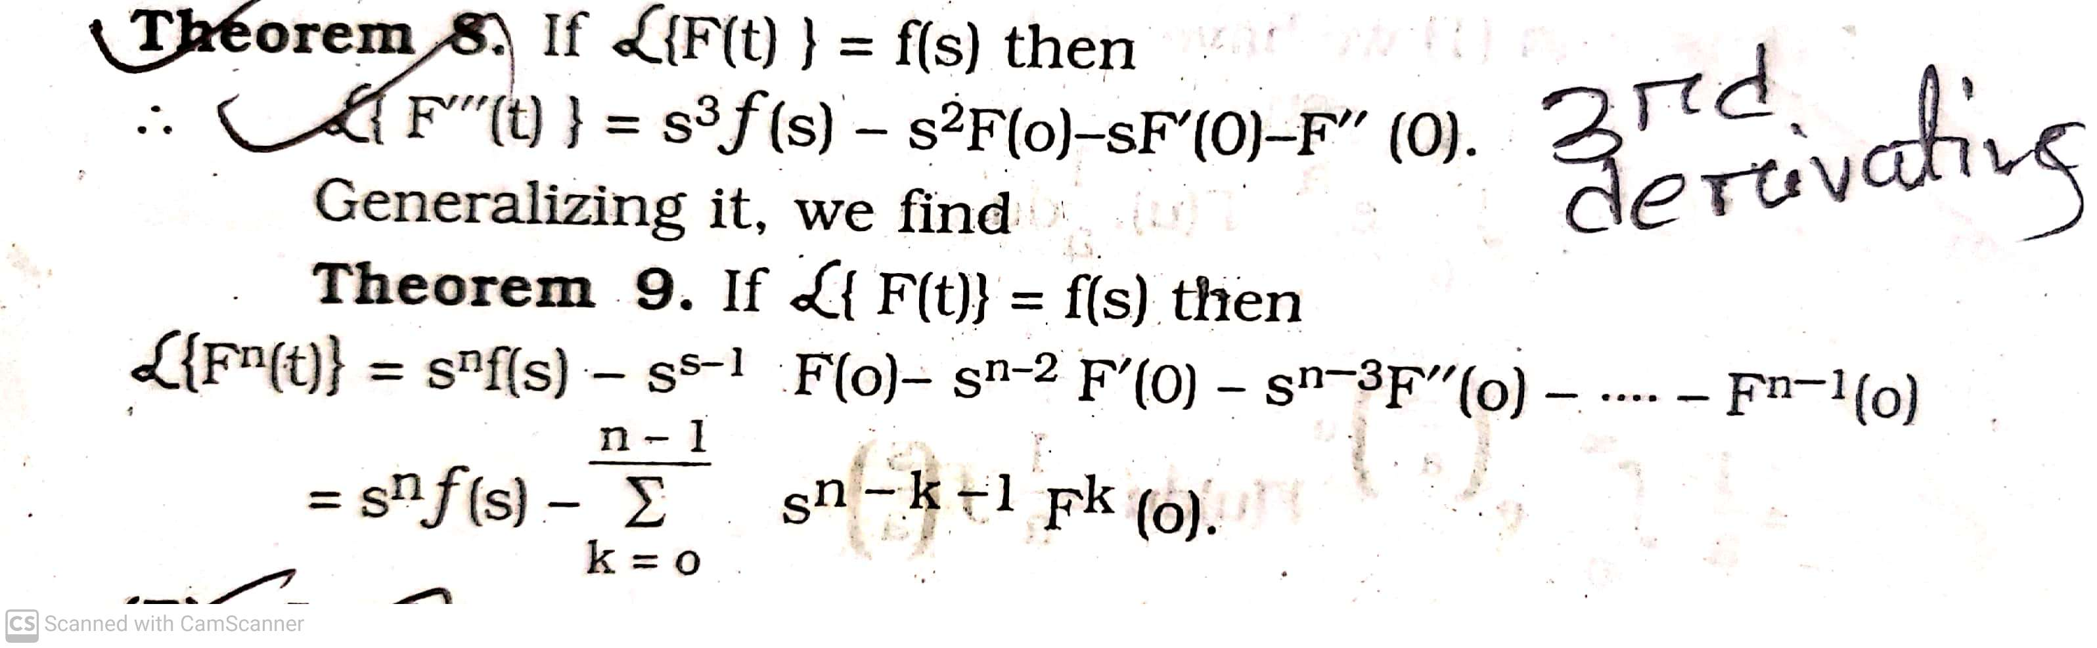

Slide 5
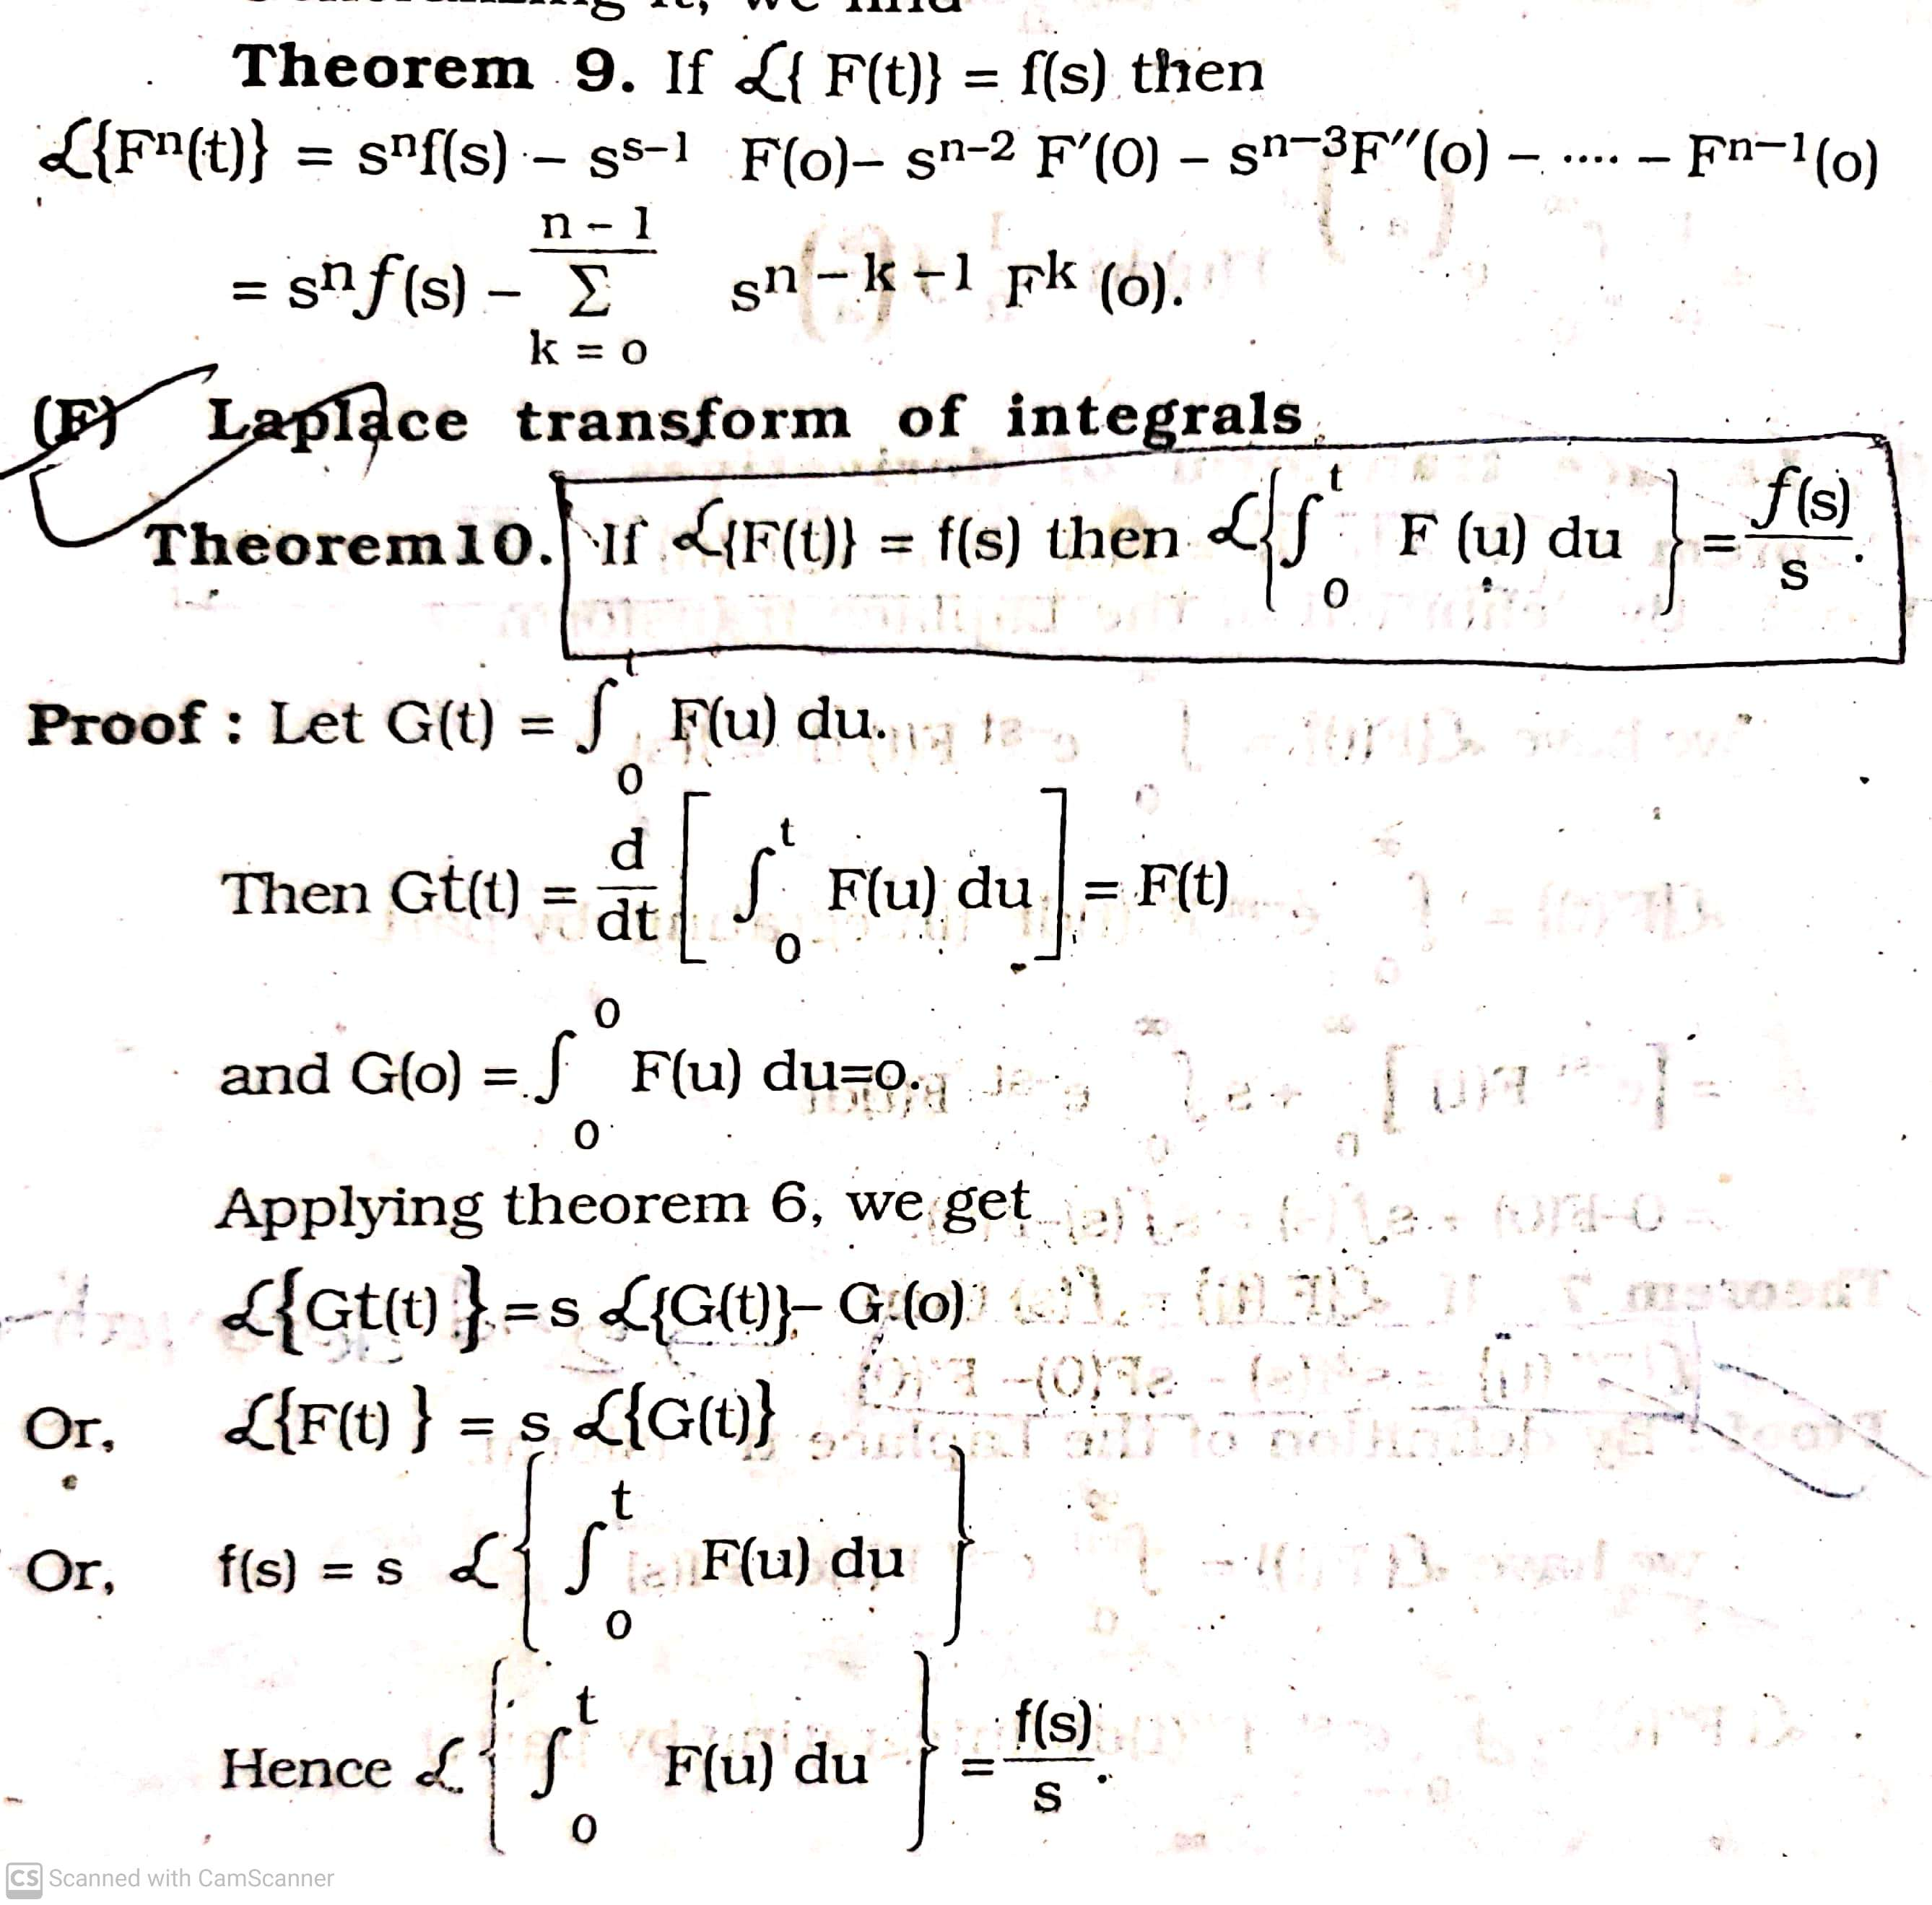

Slide 6
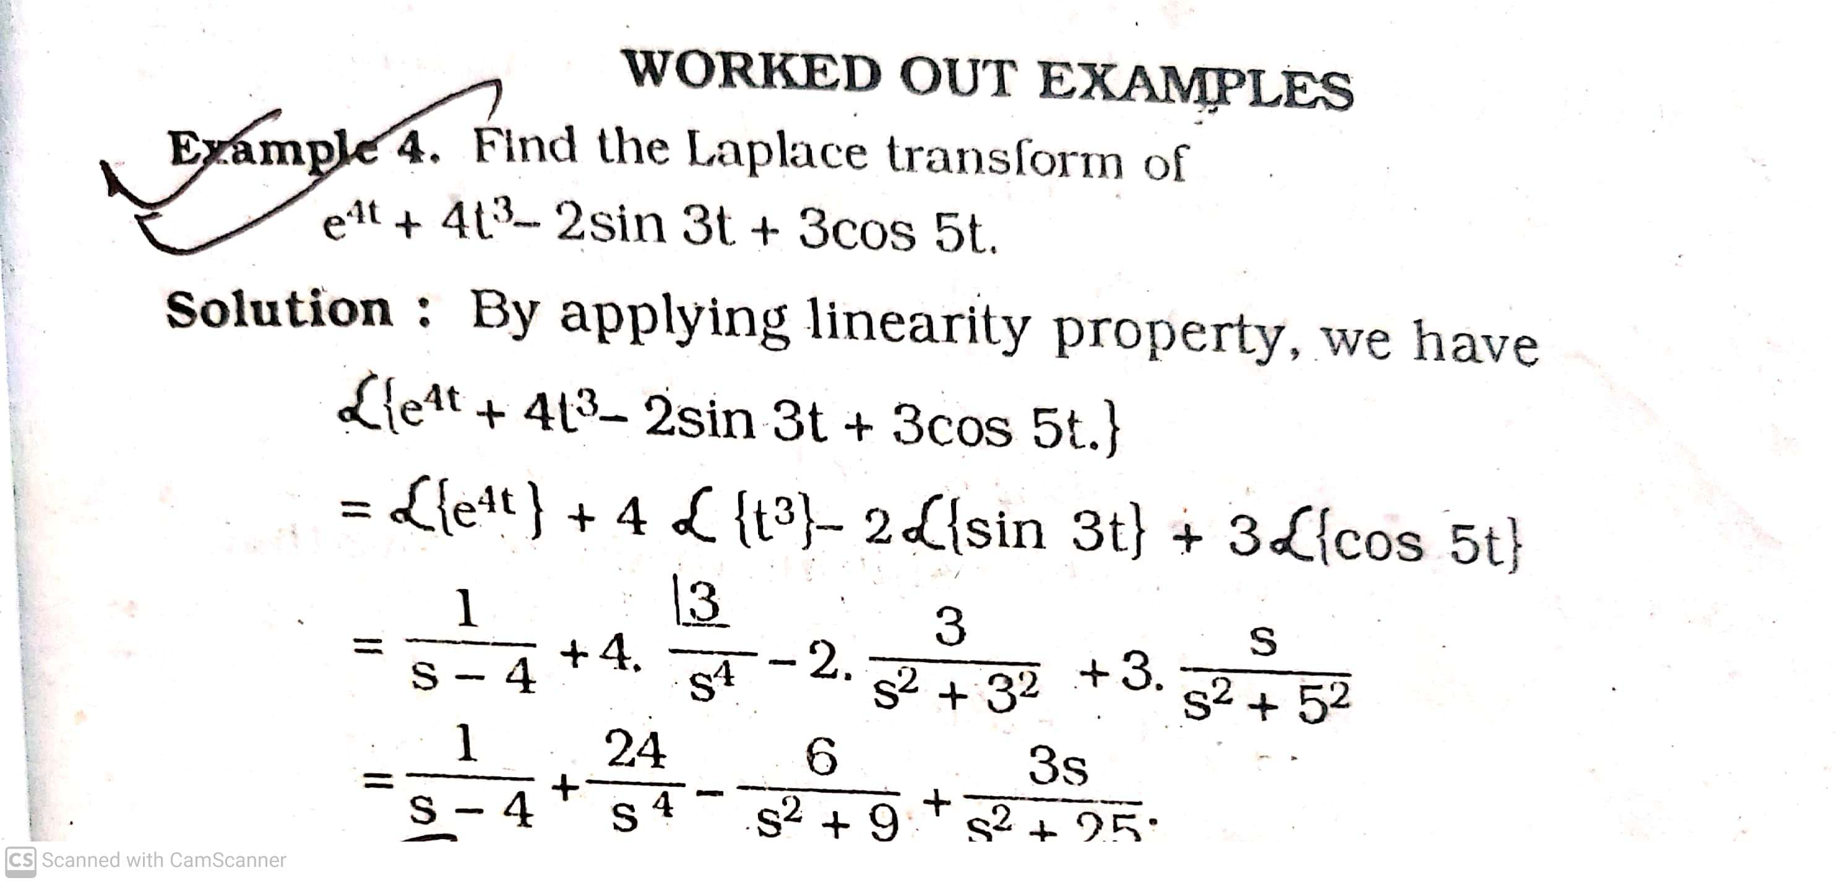

Slide 7
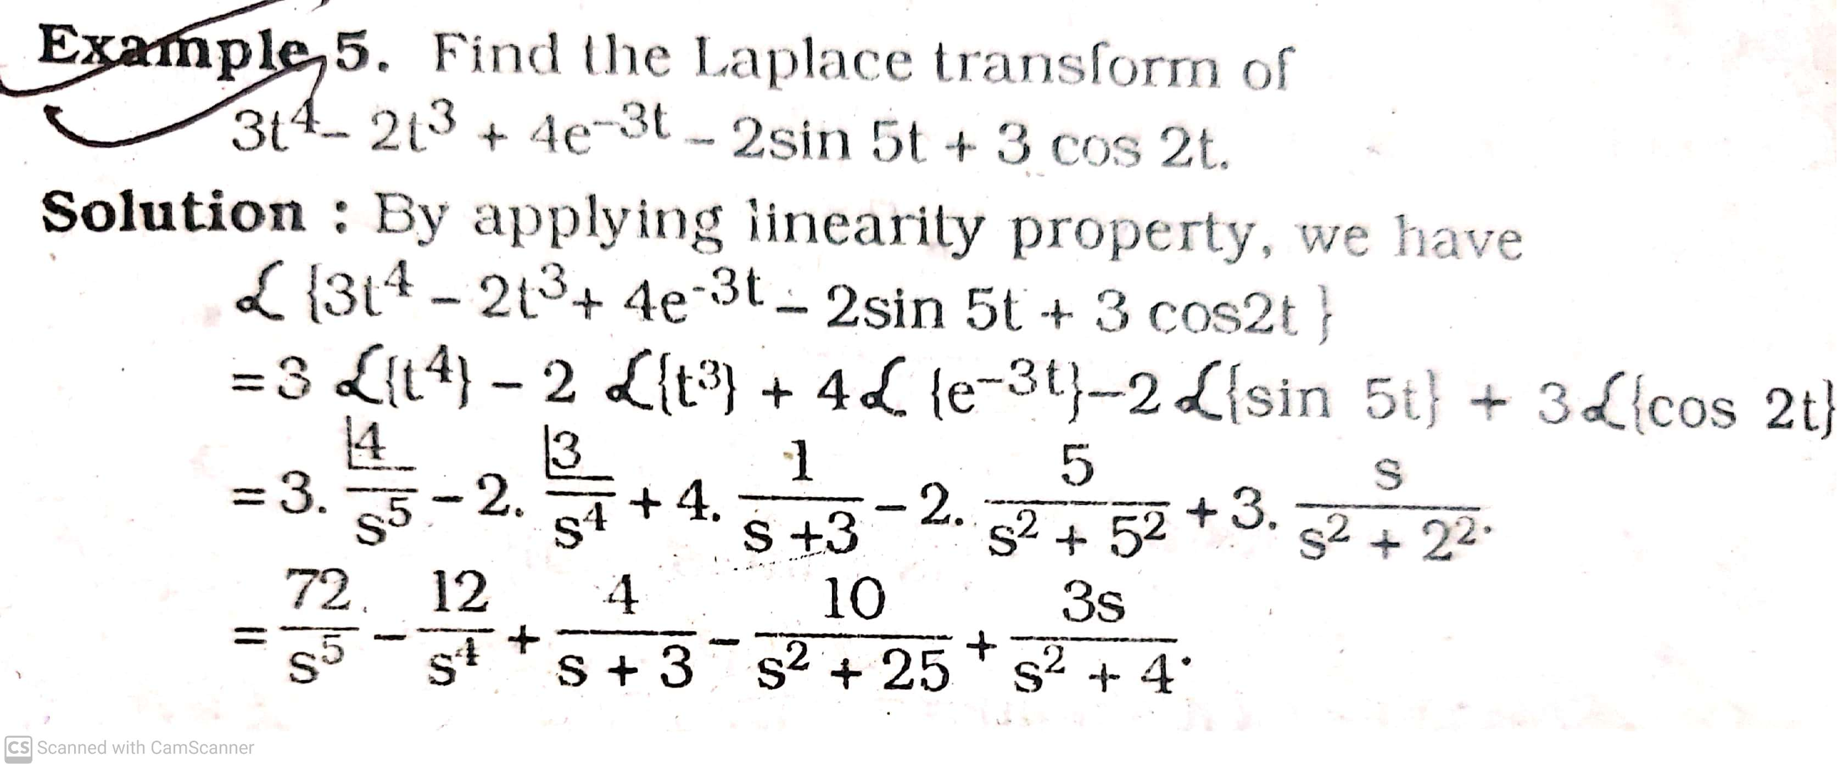

Slide 8
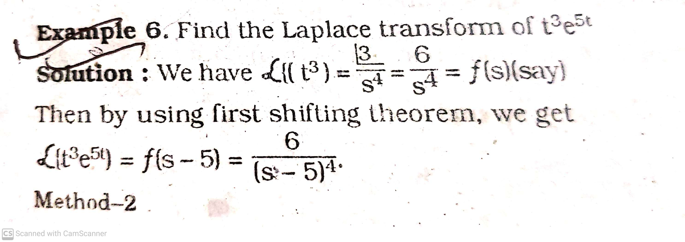

Slide 9
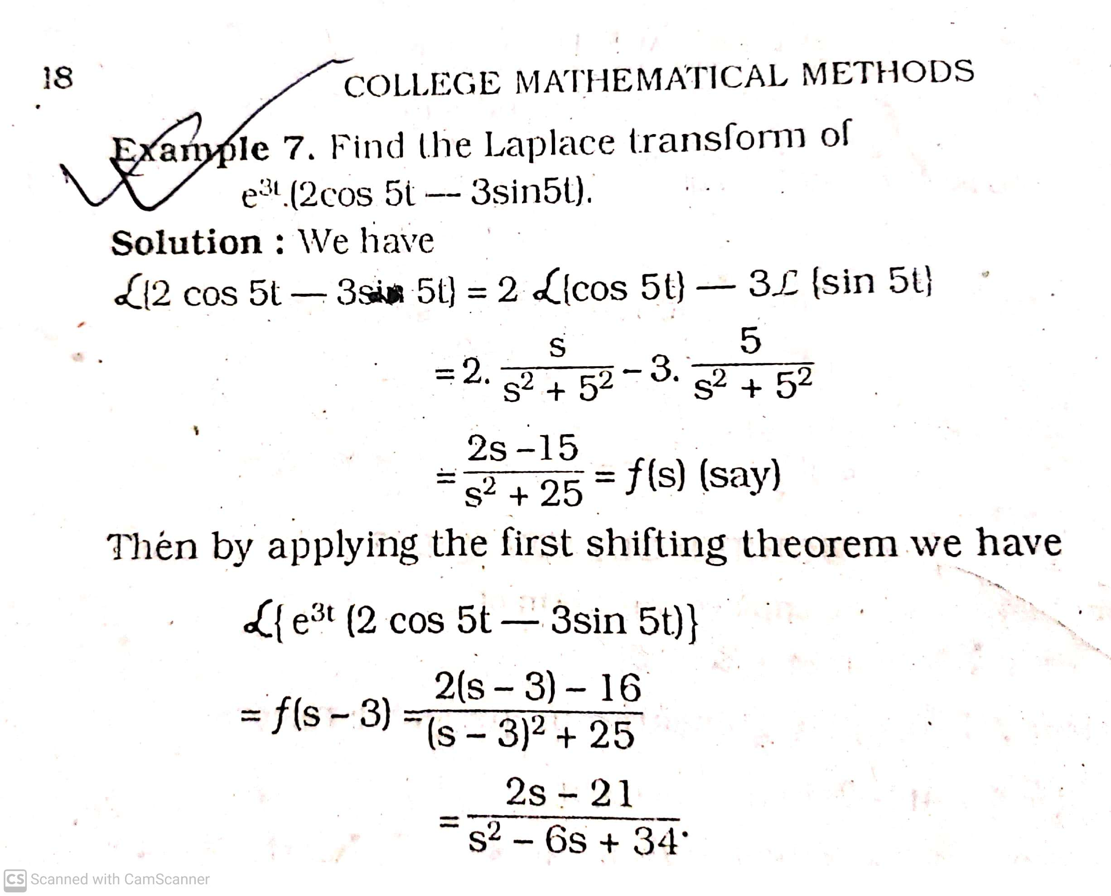

Slide 10
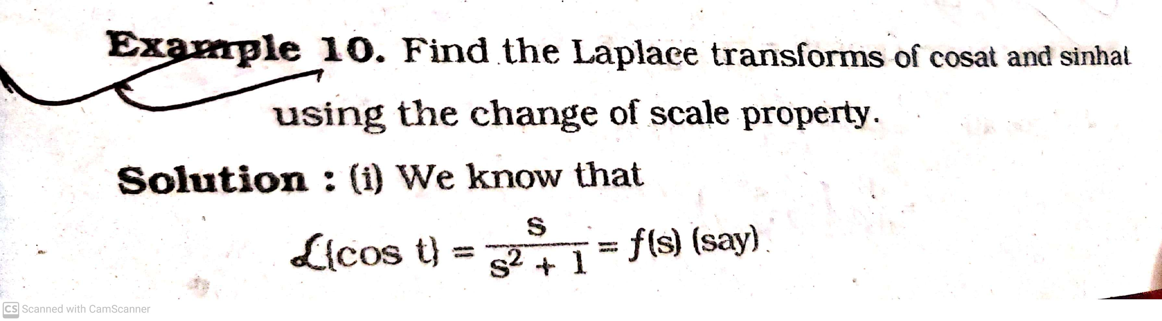

Slide 11
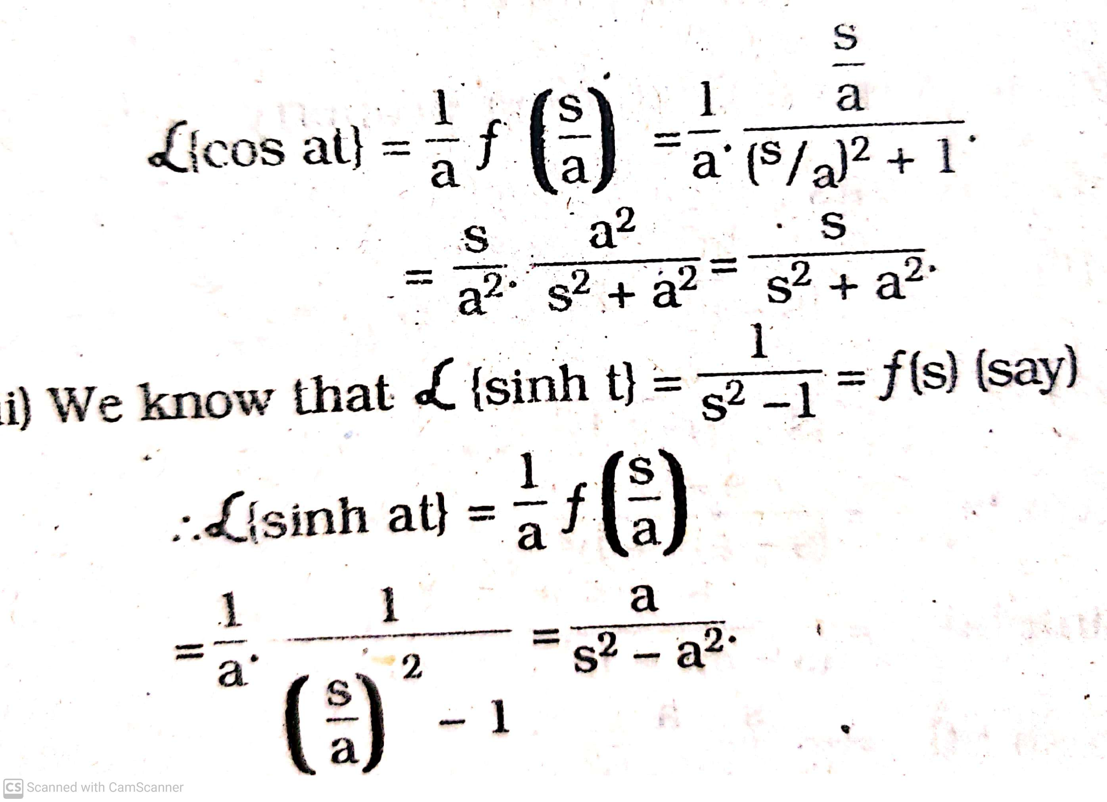

Slide 12
Thank you

